Slide 1
Face Recognition at Mini Server

Slide 2
Background
This is part of the demo of IoT.
Face recognition can be done locally at the mini server at the vicinity of sensor before transferring back to the main server/processor.
Hence, this project is aimed to perform face recognition at the local mini server.

Slide 3
Input/Output
The input is the video stream captured by cameras connected to the IoT.
Opencv2 library is used to capture the video stream and sample the image. This allowed the captured image to be transformed into Numpy array.
The final output is the face recognition result which can be transmitted to the master control.

Slide 4
Target and Application Environment
In this context, few human faces will be selected as targeted faces in this project.
Targeted faces will be captured using same camera that will be used in the testing environment.
The testing location is in an exhibition hall which has a bright lighting. There is human flow and no restriction of entry. However, camera is installed at fixed spot.

Slide 5
Complication
Multiple faces can be taken into an image frame at the same time.
Lighting can be different in between testing ground and training ground. Bright lighting (which is mainly yellow lighting that has significant R and G component) can reduce the contrast in between face and surrounding environment. Face area which is not exposed to the light may not be recognized.
Though targeted face is known, the application ground is an open space that allow free movement. Hence, accuracy varies between individual visitor.
For the targeted face, not all facial expression/hair style can be captured. Spectacle effect can also be extra factor to the recognition accuracy.

Slide 6
Proposed Flow
1. Image capturing
2. Training face recognition
3. Testing/Use the model in real time face recognition

Slide 7
Environment
Using Anaconda to install all necessary packages.
Use yml file to get the list of packages.
Create the environment based on the yml file if packages are missing.

Slide 8
Image Capturing
Using opencv2 in image capturing from video stream.
Haar Wavelet face cascade method (standard function used in opencv2) is used to capture the human face pixels.
Use MTCNN (in courtesy of MIT) to refine the face area captured using Haar Wavelet.
Disallow image capturing if MTCNN cannot capture eye/nose/mouth location.

Slide 9
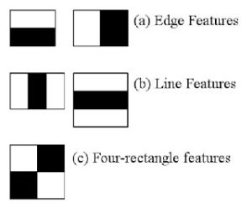
Haar Face Cascade
Haar Cascade [1] has 4 stages:
Haar Feature Selection
Creating Integral Images
Adaboost Training
Cascading Classifiers
In feature selection, it actually gets Haar features such as edge features and line features. Although not exactly a resultant of Haar Wavelet, Haar features can be calculated thru integral images method that is implemented in the opencv.
Notes:
[1] Rapid Object Detection using a Boosted Cascade of Simple Features , 2001.

Slide 10
Haar Face Cascade
For each features, we will try to find out what is the best threshold that can predict whether the trained images are human face or not.
However, not all features obtained thru integral images are useful. The model applied on the features are considered to be weak classfier as each of them only holds information at certain spatial region of the whole image.
Adaboost classfiers are actually an ensemble classfier of the weak classfier that applied on each Haar feature. Boosting allows stronger feature classifer to be ensembled as a weighted averaged strong classfier.
Finally, the Adaboost classfiers are cascaded in stages. As a result, image area that fits the face features the most are highlighted.

Slide 11
MTCNN – Face Encoding
MTCNN [2] or Multi-Task Cascaded Convolutional Neural Network is used for face landmark detection and face boundary detection.
MTCNN has 3 stages of neural networks.
At 1st stage, the input image is scaled down multiple times to build an image pyramid. Each scaled version of image pyramid is passed through it’s convolutional neural network (CNN) that knowns as Proposal Network (P-Net).
P-Net is using 12x12 kernel with strides 2 to process input image. P-Net will produce the bounding box for each 12x12 kernel. The resultant bounding boxes that had higher probability (generated by P-Net as face classification result) will be parsed to next stage.
Notes:
[2] Zhang, K., Zhang, Z., Li, Z., and Qiao, Y. (2016). Joint face detection and alignment using multitask cascaded convolutional networks. IEEE Signal Processing Letters, 23(10):1499–1503.
Explaination: https://towardsdatascience.com/how-does-a-face-detection-program-work-using-neural-networks-17896df8e6ff

Slide 12
MTCNN – Face Encoding
At 2nd Stage, all the candidate bounded images from stage 1 are fed into CNN that known as Refine Network or R-Net.
2nd stage is using 24x24 kernel on the inputs.
At each 24x24 kernel output, CNN process another set of bounding boxes and probabilities. So, we are able to reject some of the candidate images from stage 1. This is how the 2nd stage is refining 1st stage result.

Slide 13
MTCNN – Face Encoding
At stage 3rd stage, 48x48 kernel is applied on 2nd stage candidate bounded image.
While producing new bounding coordinates and probability of fitting the face feature, it also compute the face landmark coordinate.
5 face landmark points (left/right eye, left/right mouth, nose tip) are computed. The 5-points are obtained though minimization of Euclidean loss.
Best bounding coordinate and 5 face landmark coordinates are selected. Hence, 3rd stage is known as O-Network or output network.

Slide 14
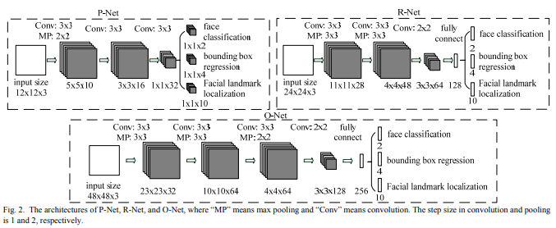
MTCNN

Slide 15
MTCNN – Face Alignment
Opencv Haar Face Cascade is based on Haar features and hence it is subjected to error where features of other object fits the threshold given.
MTCNN can identify the face landmark (eye/mouth/nose) of an image. By input Haar Cascade image into MTCNN, we can reject the image captured from Haar Cascade from further processing if face landmark coordinates is not returned from MTCNN.
In this project, the face image pixels within the MTCNN boundary will be taken (MTCNN outputs boundary coordinate instead of image).
These identified face image pixels will be resized into (160,160). The pixels which are too far away from left eye/right eye will be cropped. Forehead and pixels under mouth will also be cropped. This will reduce the noise due to varying hair style and background.
Final image will be resized again to (160,160) before input to pre-trained Facenet neural network.

Slide 16
Face Encoding
Face encoding is done through face_recognition [3] python library developed by Ageitgey. This library is mainly based on open source Dlib.
Face_recognition library return result in 128-bit code and hence suitable for face encoding.
Face_recognition has several steps to refine and encode the face image:
1. face detection using HoG (further refine bounding area from MTCNN in this project)
2. dlib face landmark detection and face projection
3. neural network trained using triplet loss for error computation
Notes:
[3] Theory: https://medium.com/@ageitgey/machine-learning-is-fun-part-4-modern-face-recognition-with-deep-learning-c3cffc121d78
Github: https://github.com/ageitgey/face_recognition

Slide 17
Face Encoding - HoG
Histogram of Gradient is an 2D array consists of gradient at each pixel. Gradient is to be computed from intensity difference across its neighbouring pixels.
Face Cascade and MTCNN should have filtered out images which are not showing sufficient face features at this point. HoG will refine the bound of image by taking out more background pixels.
HoG is working since nose, mouth, eyes should have unique gradient features and relative distance across nose, mouth, eyes, hair and background, will define the face area.
HoG is less sensitive to light intensity (Gradient usually considering surround pixels rather than light intensity at one pixel) and can define the features without influence of local light intensity. (MTCNN, face_cascade should have taken out image with extreme light intensities, so less intensity will not have side effect)
DLIB provides fast computation of HoG.

Slide 18
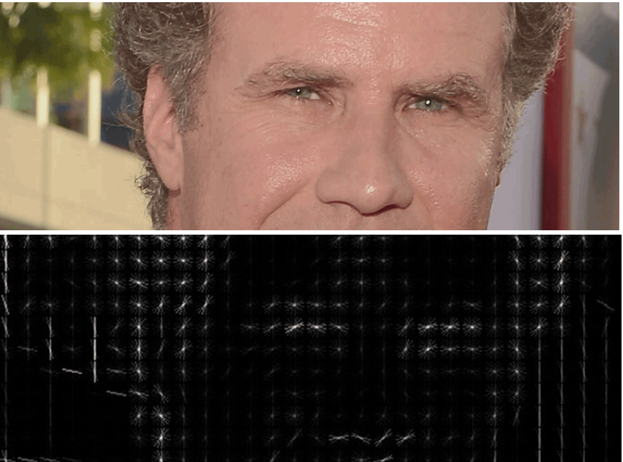
HoG Representation

Slide 19
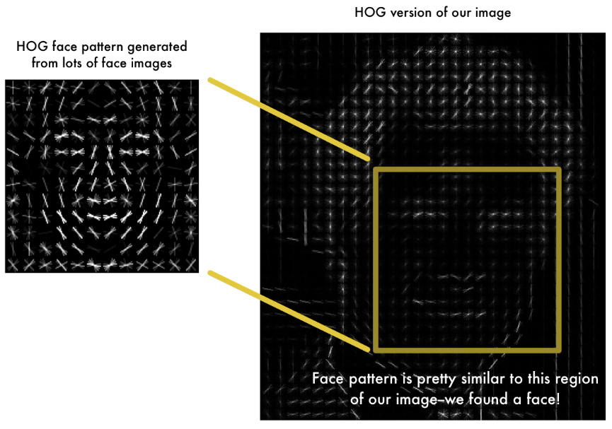
HoG based Face Recognition

Slide 20
Face Encoding – Face Landmark
With HoG refined image, Dlib is able to output 68 landmark points.
DLIB has a neural network pre-trained with 68-point iBUG 300-W dataset
With DLIB’s landmark output, face_recognition library can make face projection.
Slanting face can be re-projected with all the 68 points at largest alignment possible. Nose is at centered while the image is re-projected based on direction on other landmark point as well. (Compared to MTCNN with 5 points, total re-projection is possible)

Slide 21
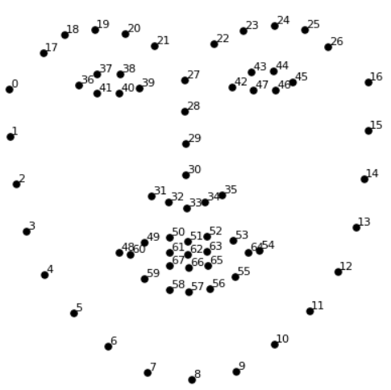
68 Landmark Points

Slide 22
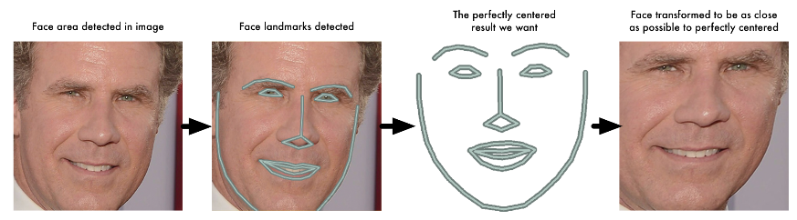
Face_recognition face re-projection

Slide 23
Face encoding
With DLIB face re-projection, Ageitgey is able to train a neural network with much less sample size. It defines the input to the network to have correct face alignment.
Ageitgey’s network is computing triplet loss for error correction.
Triplet loss computation means three images are input to the network at the same time. Though there are three images, all the image are going thru shared layers. (This means all three sub-networks are exactly the same layers with same weight)

Slide 24
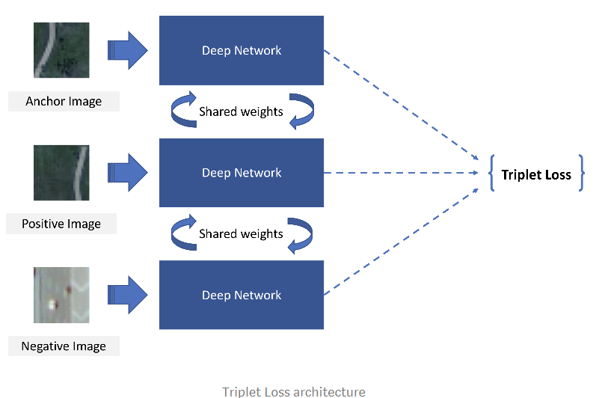

Slide 25
Face encoding
The 3 images are a training face image of a known person, another picture of the same known person and a picture of a totally different person.
With this combination, weight in between similar faces are closer while the weight in between different face are further.
This applies to all 128-bit that represent 128 measurements made at the face features.
With pre-trained weights from face_recognition python library, the face_recognition can be used with up to 98% accuracy at application time.

Slide 26
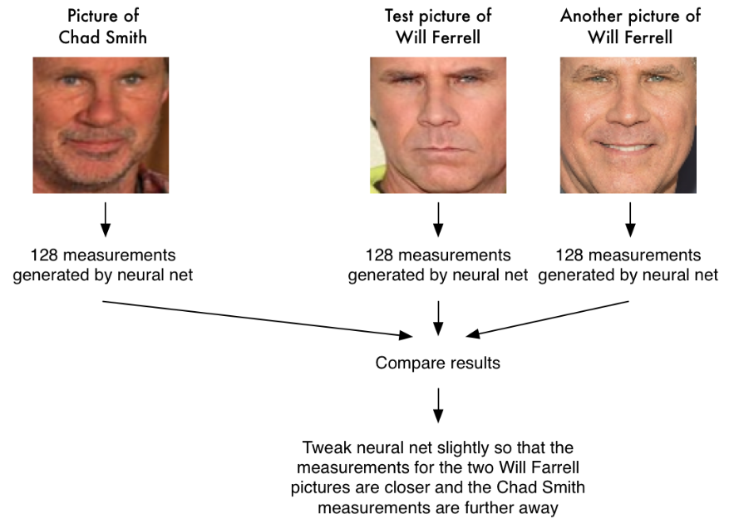

Slide 27
Facenet – Face Encoding
Facenet [3] is a deep neural network which encode the image into 128 byte code.
Facenet weights are pre-trained based on ~50 million faces.
Hence, Facenet is used to encode images into 128 byte code in this project based on the pretrained network weights.
Training of 50 million faces requires long training time. Application of Facenet saves the training time while allow the faces to be encoded without accessing to massive dataset.
Notes:
[3] FaceNet: A Unified Embedding for Face Recognition and Clustering
Florian Schroff, Dmitry Kalenichenko, James Philbin
(Submitted on 12 Mar 2015 (v1), last revised 17 Jun 2015 (this version, v3))

Slide 28
Facenet
Facenet is using shared layers to compute triplet loss of anchor, positive and negative images.
Anchor image (specific person image) should have less distance to the positive image (other image that is labelled to the same person) as compared to distance to the negative images (other images that labelled to other persons).
Triplet loss is then total squared distance of anchor image to positive image minus total squared distance of anchor image to negative image.
As a result, SGD training using ADAGRAD boosting is using to minimized the triplet loss.

Slide 29
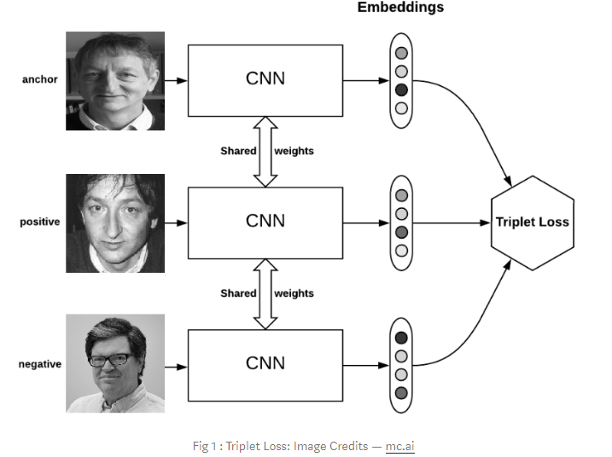

Slide 30
Face Recognition Model
3 Targeted faces and >100 non-targeted faces are pre-processed using MTCNN (Background removal), and augmented.
As a result, ~100000 images are input into pre-trained Facenet.
With the 128-byte code, it is now a smaller dataset which enables Classifier models to be trained for the final image recognition.
In this project, the objective is to recognize multiple (3) faces. Though Facenet helps to encode the image, it does not serve as final classifier.
Hence, a classifier with 128-byte code as input will have 3 binary/categorical output.
Notes:
[3] FaceNet: A Unified Embedding for Face Recognition and Clustering
Florian Schroff, Dmitry Kalenichenko, James Philbin
(Submitted on 12 Mar 2015 (v1), last revised 17 Jun 2015 (this version, v3))

Slide 31
KNN
KNN is suitable for face recognition.
Cosine distance in between 128-byte code generated from two images (thru face_recognition) is a good indicator of image similarity.
KNN can use the Minkowski distance when defining the nearest neighbor.
The accuracy is enhanced with weight reduced with the distance increased.
As a result, the accuracy can reach 95-97% in the dataset with number of neighbor set to 5.

Slide 32
SVM
SVM is also suitable for face recognition.
Transformation of the 128-byte code enables support vector plane to be found.
With good image preprocessing, facenet usually encodes the image more accurately. This makes SVM training to be feasible using 128-byte code.
SVM usually gives accuracy around 94-96%.

Slide 33
Logistic Regression
Logistic regression is suitable for binary classification using probability function.
After image is encoded into 128-byte code thru Facenet, logistic regression model is built for each targeted face.
Logistic regression is not a linear regression model and so it allow a better binary class prediction using 128-byte code.

Slide 34
MLP
Multi-layer Perceptron is also used in this context.
120 hidden layers are used in this context using lbfgs solver.
Lbfgs solver is optimizing log loss function.
Hence, it is able to provide different classification result compared to other networks.

Slide 35
Ensemble
Voting ensemble model is used on SVM/KNN/MLP/Logistic regression. This is because all the 4 models are having binary outputs.
Voting ensemble output is checked using deep neural network prediction. If the probability is not exceeding 50%, the image is not considered to be recognized.
Since there are 4 targeted face, we will perform voting for each targeted face independently. If an image is recognized to be 2 or more targeted faces, it will not consider to be recognized by the model. This is to prevent cloze ambiguity.

Slide 36
Deep Neural Network
While KNN/SVM/MLP/Logistic regression gives binary output, deep neural network is able to compute the output in the form of probability.
In this project, the neural network is designed to have 3 stages.
The 1st stage consists of dense layers which accepts 128-byte code generated by the Facenet.
The 2nd stage consists 4 sets of dense layers which also accepts 128-byte code.
At 3rd stages, we have 4 outputs. At each output, it inherits output of each 2nd stage dense layer. It finally concatenates with 1st stage output. After flattening and further dense layers, it will produce softmax output for each targeted face.
As a result, we will avoid weight to be concentrated on 1 of the targeted faces.

